Slide 1

Year 2
Parents Workshop
Reading, Writing and maths

Slide 2
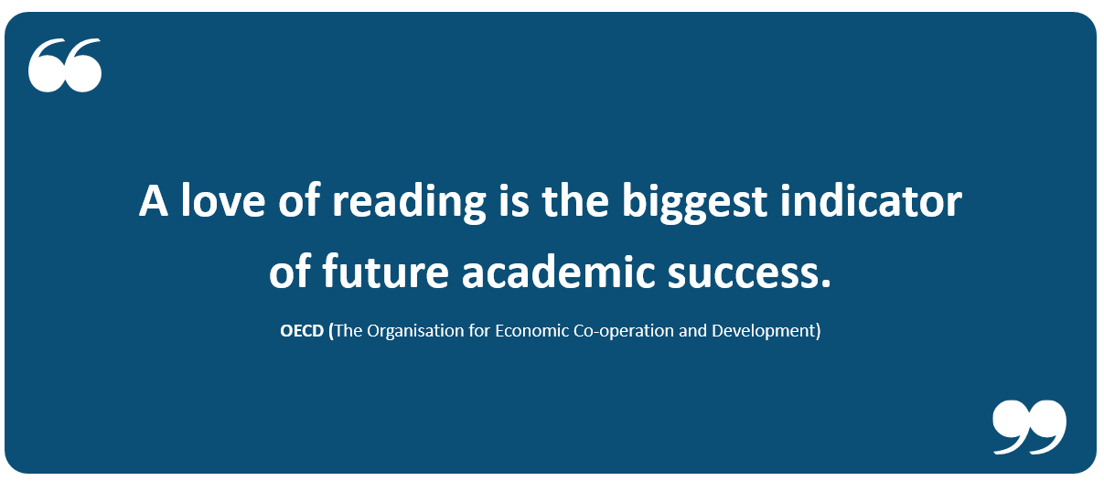
Reading in Year 2

Slide 3
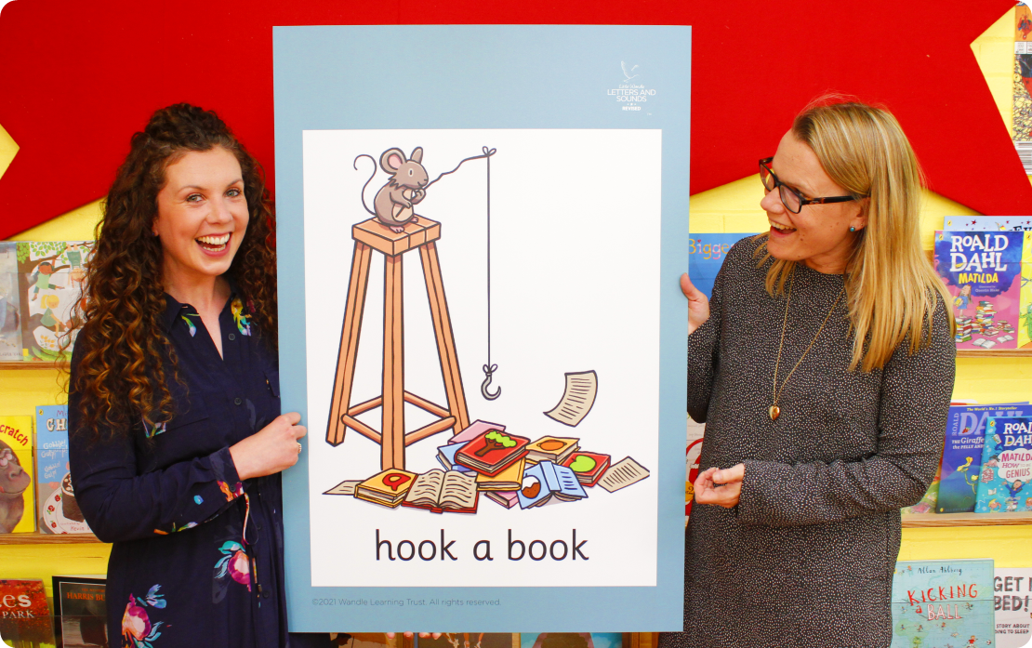
Phonics in Year 2
Our school has chosen Little Wandle Letters and Sounds Revised as oursystematic, synthetic phonics (SSP) programme to teach early reading and spelling.
We use this approach in Reception
and Year 1.

Slide 4
Our school is using Little Wandle Rapid Catch-up Programme to support pupils not currently reading at age-related expectations in Year 2 and above. The programme has a fast pace, so the children can access the curriculum and enjoy reading as soon as possible.

Slide 5
Phonics in Year 2
4 Sessions as week.
Each morning for 20 minutes.
Fast-paced approach.
Lessons encompass a recap of phase 3, 4 and 5 phonemes, blending and segmenting of words to read and spell.
All Year 2 children who did not sit or did not pass the Phonics Check in June 2025 will re-take the Phonics Check in the week commencing 8th June 2026.

Slide 6
Reading Skills
1) Phonics and Word Recognition
• The ability to recognise words presented in and out of context.
• The ability to blend letter sounds (phonemes) together to read words.
2) Understanding
• The ability to understand the meaning of the words and sentences in a text.
• The ability to understand the ideas, information and themes in a text.
• If a child understands what they hear, they will understand the same information when they read.

Slide 7
Spelling Shed
4 Sessions as week.
Each morning for 20 minutes.
Fast-paced approach.
Lessons focus on a new spelling rule each week linked to the national curriculum for year 2.
These include prefixes, suffixes, homophones, contraction words.
In reading diaries you have a log in for spelling shed for extra practise at home.

Slide 8



How do we teach reading in books?
Guided Reading practice sessions:
Four times a week.
Children read the same book and complete a range of comprehension activities.
Notes:
Slide purpose:
To introduce decodable readers
Suggested script:
The children read the same book three times in a week.
The first time we work on decoding (sounding out) the words, the second time we work on prosody which is reading with expression – making the book sound more interesting with our ‘storyteller voice’ or our ‘David Attenborough voice’, and the third time we look at comprehension.
We read the books three times at school because we want to develop the fluency. The more they see words the more they begin to read them automatically without having to sound them out.

Slide 9
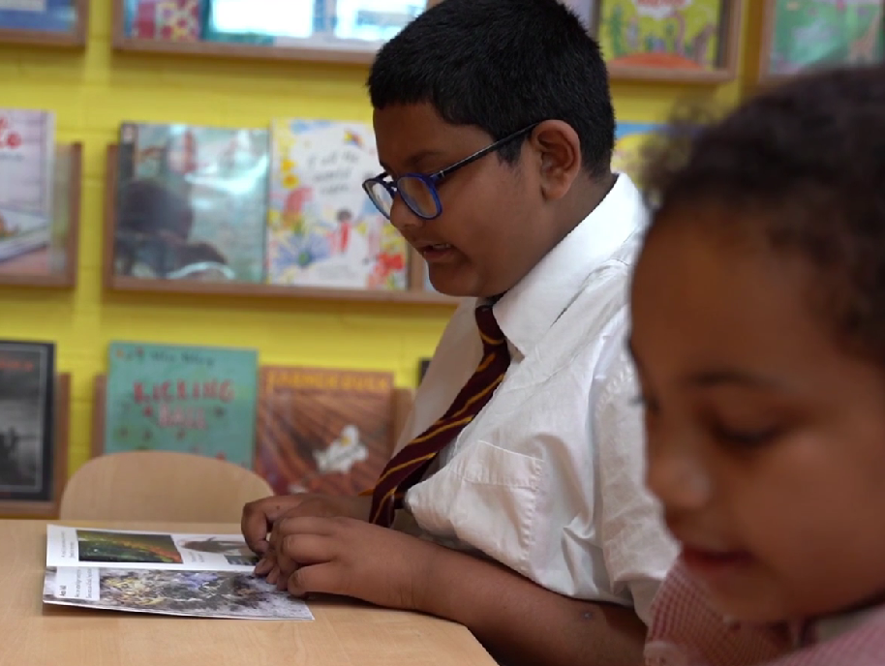
Reading a book at the right level
This means that your child should:
know all the sounds and tricky words in their phonics book well
read many of the words by silent blending (in their head) – their reading will be automatic
only need to stop and sound out about 5% of the words
Notes:
Slide purpose:
To provide an overview of book matching.
Suggested script:
Blending in your head means children say the sounds quietly in their heads and then read the whole word out loud. Eventually, this will become automatic and children can read words that they know fluently.

Slide 10
Reading a book at the right level
Comprehension:
Retrieval – finding answers in the text
Summarise – recall what they have read
Inference – “reading between the lines”
Prediction – using the text to make logical guess about that might happen
Notes:
Slide purpose:
To provide an overview of book matching.
Suggested script:
Blending in your head means children say the sounds quietly in their heads and then read the whole word out loud. Eventually, this will become automatic and children can read words that they know fluently.

Slide 11

Reading at home!
The most important thing you can do is read with your child.
Reading a book and chatting had a positive impact a year later on children’s ability to…
understand words and sentences
use a wide range of vocabulary
develop listening comprehension skills.
Notes:
Slide purpose:
To introduce the values of reading at home
Suggested script:
You play a crucial part in your child's reading and the most important thing you can do is read with them.
Read the slide.
Celebrate child’s success at school.
Make time for reading at home!

Slide 12


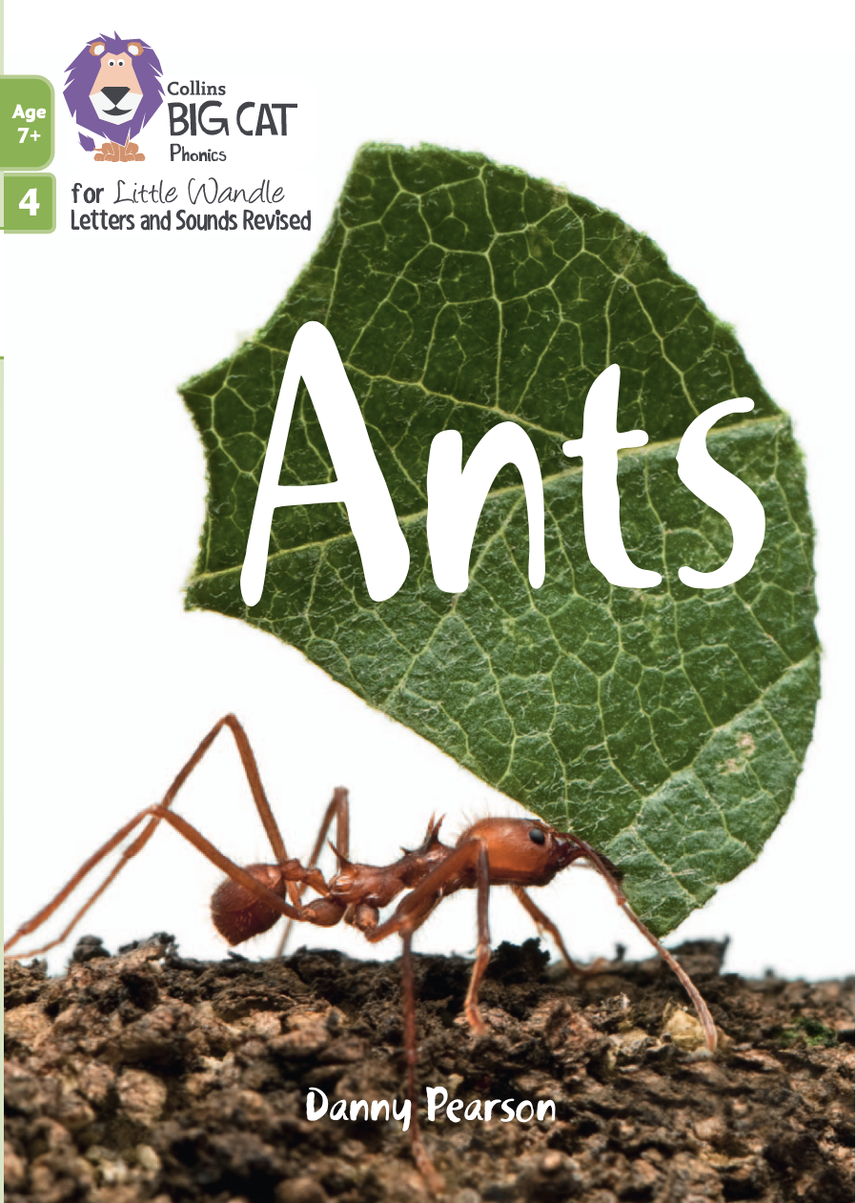


Books going home
Notes:
Slide purpose:
To summarise the format of reading at home
Suggested script:
As well as the ‘learning to read’ book that your child will bring home they will also bring home a book for sharing with you.
This book is SO important. This is how we are going to give them the WILL to read.
Please read with your child as often as you can – at least once a day if possible.

Slide 13
Listening to your child read their phonics book
Your child should be able to read their book without your help.
If they can’t read a word, read it to them.
Talk about the book and celebrate their success.
Notes:
Slide purpose:
To provide guidance on reading the decodable reader at home
Suggested script:
Your child will bring home their phonics book, matched to their reading ability, which they will have already read in school.
The purpose of this book is to practise their fluency.
If your child is finding a word hard to read, encourage them to sound and blend.

Slide 14
Read to your child
The choosing book is for YOU to read:
Make the story sound as exciting as you can by changing your voice.
Talk with your child as much as you can:
  Introduce new and exciting language.
  Encourage your child to use new vocabulary.
  Make up sentences together.
  Find different words to use.
  Describe things you see.
Notes:
Slide purpose:
To provide guidance on reading the shared book at home
Suggested script:
Reading to your child daily can open a variety of doors to your child's education, imagination and well-being.
Read the slide.
As a school, we also prioritise reading to the children daily to encourage the love of reading.

Slide 15
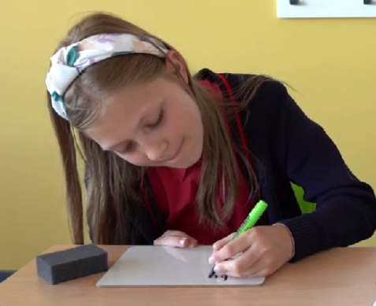
Spelling
Say the word.
Segment the sounds.
Count the sounds.
Write them down.
Notes:
Slide purpose:
To introduce spelling
Suggested script:
Model the process above on a flipchart for the parents to see.

Slide 16
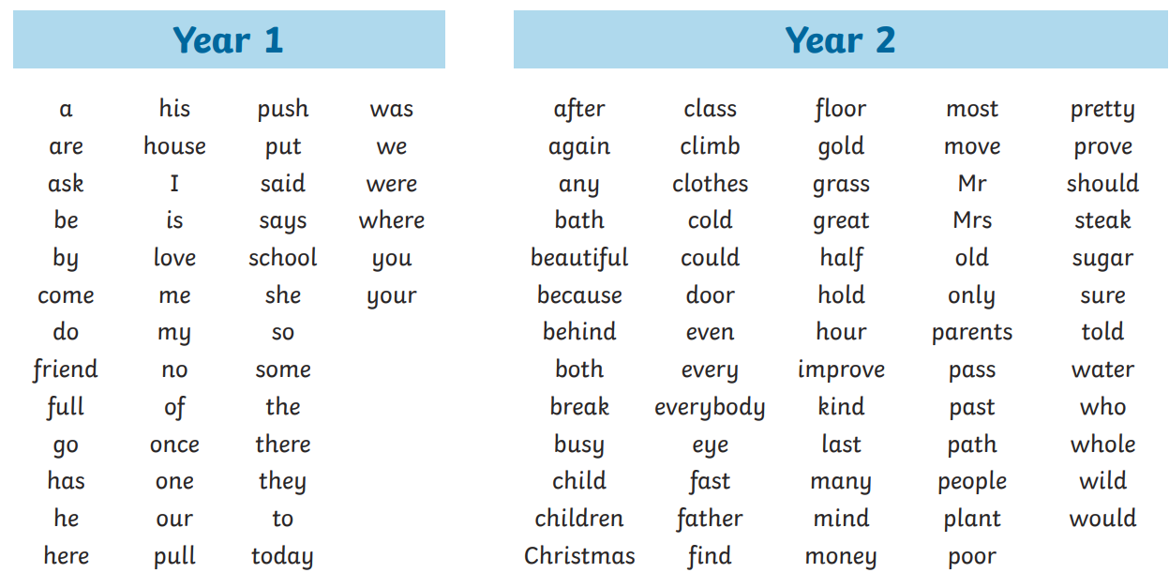
Tricky words (CEW)
Notes:
Slide purpose:
To introduce tricky words
Suggested script:
So, what are tricky words?
Have a look at the ‘How we teach tricky words’ video on the website: https://www.littlewandlelettersandsounds.org.uk/resources/for-parents/

Slide 17
Writing
Handwriting sessions 4 times a week.
Each morning for 10 minutes.
Focuses on joining letters,
English sessions 4 times a week.
Each morning for around 45 minutes.
Expectation to write independently and gain stamina for writing to write at length.
Notes:
Slide purpose:
To introduce tricky words
Suggested script:
So, what are tricky words?
Have a look at the ‘How we teach tricky words’ video on the website: https://www.littlewandlelettersandsounds.org.uk/resources/for-parents/

Slide 18
Maths
Maths sessions 4 times a week.
Each morning for around 45 minutes.
Mastering number 4 times a week.
Each afternoon for around 15 minutes.
Children who are not working at age related expectations will participate in First Class At Number 3 times a week.

Slide 19
Maths
Fluency:
Involves knowing key mathematical facts and being able to recall them quickly and accurately.
This means being able to apply the same skill and knowledge to multiple contexts and be able to choose the most appropriate method for a particular task.
We teach the content using a range of concrete resources to deepen the children’s understanding by having them represent it in a variety of ways, ensuring that all children have sufficient time to practise what has been taught.
We move from concrete materials, to pictorial representations to abstract questions. We encourage children to continue to use the resources to solve their problems and help to justify the answers.

Slide 20
Maths
Reasoning:
Reasoning in maths is the process of applying logical thinking to a situation.
Because we teach a range of strategies, this give children a solid base and skill level to use the correct problem solving strategy for a given question. They are encouraged to use their mathematical language and methods to describe the solution.
It is the “how do you know…?” or “why is the answer six and not seven?”
Mathematical reasoning is the bridge between fluency and problem solving. It allows pupils to use their fluency to accurately carry out the problem solving.

Slide 21
Maths
Problem Solving:
It is a process or series of processes to solve mathematical problems. This follows, logic, reasoning and communication.
Problem solving in maths is finding a way to apply knowledge and skills you have to answer unfamiliar types of problems.

Slide 22
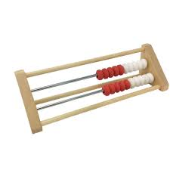
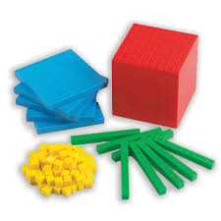
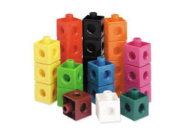
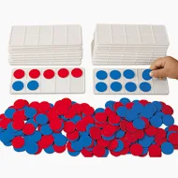
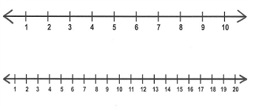
Resources

Slide 23

Cubes
Making groups of numbers.
Counting out 10s to make towers
of 10 and 1s.
Sharing for division

Slide 24
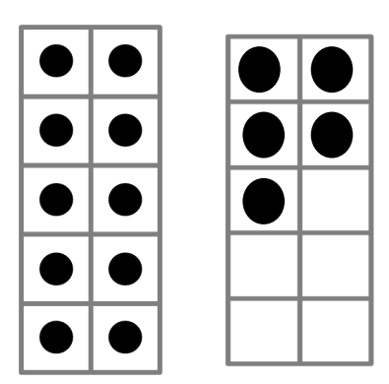
10 Frames
Use 10 frames to represent numbers in different ways. Identify 10s and 1s.
Can be used for addition and subtraction. Finding number bonds.

Slide 25
Dienes
Building numbers to 100.
Understanding 10s and 1s.
Used for addition and subtraction.

Slide 26
Number lines
Used for addition by jumping forwards.
Used for subtraction by jumping backwards.
Understanding place value of greater and less.

Slide 27
Rekenreks
Key resource used in mastering number sessions.
Used for focusing on numbers within 20.
Identifying amounts without counting.

Slide 28
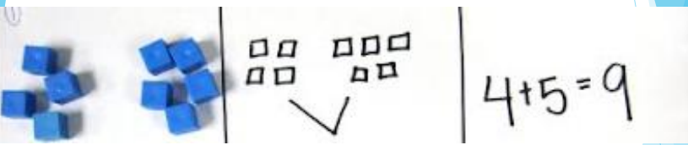
Concrete, Pictorial, Abstract

Slide 29
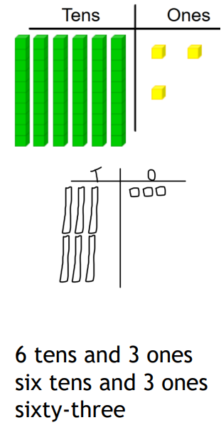
Concrete, Pictorial, Abstract

Slide 30
Maths at home
In reading diaries you have a log in for Numbots focusing on fluency, addition and subtraction.
Log in for TT Rockstars focusing on multiplication and division.
Weekly maths homework linked to learning that week in class.

Slide 31
Any questions?

